Slide 1


WELCOME
Beaker Under Pressure: What's Not Working and How Do We Fix It?
Lori Johnson · Consulting Services · Data Innovations
Grant Restorick · Sr. Product Manager · Data Innovations
1

Slide 2


TODAY'S AGENDA
What we'll cover
1
What's New
V55-57 release highlights
2
Integrating Infinity
Roche navify Lab Operations
3
Worklist Manager / Variant Driver
New capabilities for Beaker workflows
4
Questions & Comments
Open discussion
2
Notes:
Here is an overview of what we will be covering in the next 45 minutes.
First on the agenda is a review of updates to the Beaker driver since our last User Group in 2025
I will then hand it over to Lori, who will talk through some of the non-technical changes that have been made to support you on your DI-Beaker journey.
Next up, I am going to walk through a couple of workflow challenges that have been seen at different customers and how we are looking to standardize our approach
How to integrate your Instrument Manager with Roche navify Lab Operations to ensure efficiency of communication whilst preserving the necessary routing information
Leveraging the new Worklist Manager driver to ensure alignment between Beaker’s Batch Editor and downstream worklist creation.
Integration with Beaker’s Variant Module for variant discrete result processing
Finally, we want to open the floor to hear from you on any future enhancements you would like to see between Instrument Manager and Beaker.

Slide 3

WHAT'S NEW — V57
Release Highlights
Custom Priorities
Highest priority leveraged; STAT recognized correctly
HL7 Retry Logic
Acknowledgment SYNC — no more false failures
Order Questions & Responses
Fasting, FiO₂, and other OBX-29 QST fields
Microbiology OBR-29 Fix
Compatible with Epic May 2025 and later
Usability Improvements
Config dropdowns, multi-line addresses, thin client utility
3
Notes:
So firstly, What's New?— v57 (~7 minutes)
- Since last year, we have created 2 new versions of the Beaker driver with v57 anticipate at the end of the month.
OPENER (30 sec):
“These updates bring a mix of targeted reliability fixes and forward-looking enhancements. There are five main items — let me walk through them."
STAT PRIORITY (1.5 min):
"This update came from a customer reported issue. Previous driver versions determined STAT priorities of a sample if an order was received with a priority of “S”. However, the actual value sent is configurable within a mapping table in Beaker and, in this case was configures to send the word 'STAT’. That mismatch caused STAT orders to silently fall back to routine priority — they still arrived at the instrument, but without the urgency flag.
We have updated the driver to allow users to define the mapped values for all priorities so that the appropriate priority is always applied.
The driver has the same defaults as Epic, so if you haven’t made any changes within the table, no updates to your driver configuration are needed.
HL7 RETRY LOGIC (1 min):
“This is a smaller but important fix: if the HL7 connection hiccups and the driver retries sending a result, the third attempt was being incorrectly marked as 'unable to transmit' — even when a valid acknowledgment came back. This is now fixed, so retry scenarios complete cleanly.
Note that this does not address the scenario where no response is sent within the expected scenario. To address this, the LIS Timeout configuration option can be increased.
ORDER QUESTIONS (2 min):
"This is a forward-looking enhancement driven by Epic. They've added the ability to send clinical question responses along with outbound orders — things like fasting status for a cholesterol panel, or fraction of inspired oxygen for a blood gas. These travel in OBX segments flagged with OBX-29 = 'QST' before the normal component segments. Some instruments use this contextual data to automatically calculate or adjust results, eliminating manual data entry at the instrument. This feature is off by default in Epic and requires coordination with your Epic team to enable — but v57 is ready to receive it.“This information can also be parsed and then leveraged by rules, depending on the specific workflow needs.
MICROBIOLOGY OBR-29 (1 min):
"A targeted fix for sites running Epic May 2025 or newer. The format Epic uses for the OBR-29 parent number was never being built correctly by the driver, since v1. However, until recently, this field was being ignored and therefore not causing any issues. Epic added logic in their May 2025 release which now flags this and generates 'Test Code Received in Unexpected SubComponent' errors.
In the majority of cases, this has no impact on end-to-end functionality but this fix aligns with the current Epic spec so microbiology result routing works cleanly without generating unnecessary or confusing errors. We have recently seen a couple of cases where this field IS being used, so this correction becomes more relevant"
USABILITY (1 min):
"Three smaller items: connection name dropdowns in the Destination Configuration screen now resize correctly when you expand the column — a usability frustration for large systems.
Multi-line patient addresses can now be fully parsed in accordance with Epic’s latest specifications.
And the Utility screen can now be launched from thin client users, which had been showing 'cannot connect to server' since v54.“
I’m now going to hand it over to Lori who will take you through some helpful documentation improvements.

Slide 4

WHAT'S ELSE IS NEW
Helpful Documentation
Beaker Driver Validation Guidebook
Step-by-step validation approach for Beaker driver builds
Setting up QC to Send to Beaker
White paper: QC configuration and transmission to Beaker
Release Notes on My DI Community
Latest driver release notes, available in the DI community
4

Slide 5
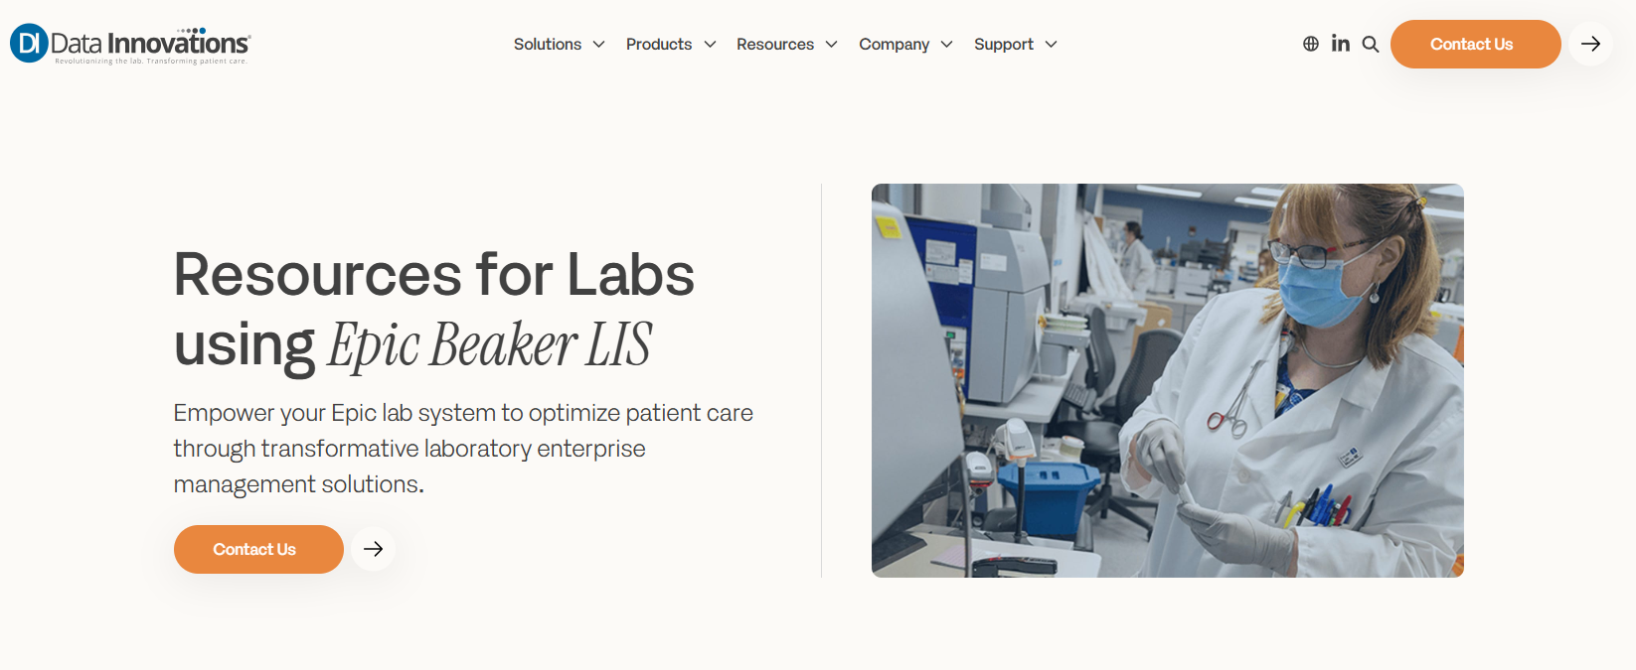
LABS USING EPIC BEAKER
Resources for Labs using Epic Beaker LIS
Empower your Epic lab system to optimize patient care through transformative laboratory enterprise management solutions.
Coming soon!
datainnovations.com/solution/labs-using-epic-beaker/
If you would like a copy of the Beaker Driver Validation Guidebook or the Setting up QC to Send to Beaker, email ljohnson@datainnovations.com
5

Slide 6
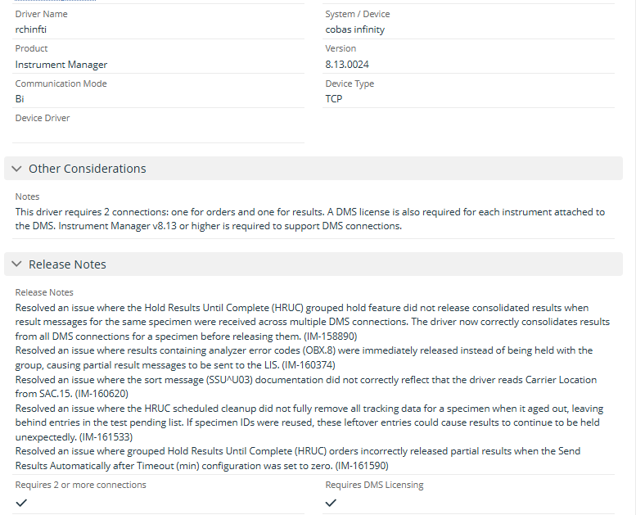
MY DI COMMUNITY
Release Notes on My DI Community
Full driver release notes — every version, with other considerations.
6

Slide 7

INTEGRATING INFINITY
Integrating Infinity
navify Lab Operations
7
Notes:
One solution that our consultants are often asked to integrate is connectivity with Roche’s navify Lab Operations middleware, often referred to by its original name Infinity.
As the amount of instrumentation and automation connected through navify grows, we saw a performance impact on the Instrument Manager system that connects navify to Beaker.
In this section, I will provide guidance on optimal configuration to avoid performance issues as your system grows.

Slide 8

INTEGRATING INFINITY
The Problem: Cluster Routing Overhead
Route orders through the cluster
Orders + Results + up to 60 virtual connections, all grouped together
1 order → 60+ copies
Each copy fires rules, triggers queue processing
Real performance impact
Not an Infinity problem — a routing model problem
Why we did this
Standard approach for other LIS; Beaker needed a better path
8
Notes:
Roche Infinity Integration — The Problem (~6-7 minutes)
OPENER (1 min):
"Before we talk about how we solved this, let's set the stage — because to understand why this was a problem, you need to understand how Infinity (and other middleware integrations) were traditionally set up with Instrument Manager."
THE TRADITIONAL SETUP (2 min):
"Roche Infinity is a middleware platform — it sits between Instrument Manager and the analyzers, managing routing, reflex testing, and result processing at the instrument level. When you connect Infinity to IM, the standard guidance was: create an Orders connection, a Results connection, and then a virtual or DMS connection for every unique instrument module that Infinity reports from. And then — you put all of those virtual connections into a cluster, and you route your Beaker orders to that cluster."
"On the surface, that sounds reasonable. Infinity needs to know about every module, and the cluster keeps the orders and results databases in sync.
Instrument Manager can identify which analyzer generates the results and pass this information back to the LIS.
This was the documented approach, and it was specifically called out to configure it as such in the help file. This works well for LIS that do not specify a destination for the order (or only the navify order connection)"
THE MULTIPLIER PROBLEM (2 min):
"Here's where it breaks down with Beaker. When IM routes an order to a cluster, it doesn't send one order — it fans the order out across every connection in that cluster. Every connection gets a copy. Every copy fires your request rules. Every copy goes into the queue. If you have 60 connections in that cluster, one Beaker order becomes 60 IM orders."
"At one customer site, that's exactly what happened. They had 62 clustered connections representing all the separate instrument modules connected through Infinity. Their queue processing overhead had grown significantly, and they weren't sure why. When we dug in, the root cause was the cluster and the fact that requests were being unnecessarily routed to ALL of the DMS connections.
“Because of the way that Beaker orders are built and specify the valid destinations for each test, there is no need to implement the cluster approach."
UNCHALLENGED ASSUMPTION (1 min):
"The unfortunate part of this story is that our own documentation telling customers to do this. We had written it up as the Infinity standard. Nobody had stopped to ask whether clusters were actually necessary for Beaker customers — or whether they were just a carryover from a different LIS workflow. So the next slide is how we answered that question."

Slide 9
INTEGRATING INFINITY
The Solution: Route Without the Cluster
Skip the order cluster
70–80%
Virtual connections still exist for results; they just don't receive orders
Separate configurations
efficiency gain
Rules fire only where they're relevant
Group modules — fewer connections
Based on internal testing. Standardizing approach for future implementations.
Instrument ID + destination mapping preserve Epic requirements
9
Notes:
Roche Infinity Integration — The Solution (~7-8 minutes)
THE SHIFT (1 min):
"The fix turned out to be simpler than we expected: stop routing orders through the cluster. That's it at the headline level. Let me walk through what that actually means in practice."
DIRECT ORDER ROUTING (2 min):
"Instead of routing Beaker orders to the cluster, route them directly to a physical Results connection. Give that Results connection a method that carries the identifier Infinity needs — what was previously served by the cluster name. The virtual connections still exist for result processing; Infinity still reports through them. You're just not sending orders down all 60 paths anymore."
"The cluster can still exist if needed for result rels — we're specifically talking about not routing orders to it. One order goes to one connection. Rules fire once. The queue stays clean."
SEPARATE CONFIGURATIONS (2 min):
"The second piece is separating your configurations. Right now, many sites have their Orders/Results connections and their DMS/virtual connections all under the same configuration. That means when a request rule fires, it fires on every connection — including all the dummy ones."
"Put your Orders and Results connections in Configuration A. Put your DMS and virtual connections in Configuration B. Now request rules only see the connections they're actually relevant for. This alone can dramatically reduce rule execution overhead even if you keep the cluster."
RIGHT-SIZING CONNECTIONS (1.5 min):
"The third lever is connection count. Rather than creating a separate DMS connection for every individual Roche module. That's how you get to 60+ connections. In many cases you can group modules, use instrument ID mapping, or use destination mapping to preserve the reporting granularity Epic needs without creating a unique routed path for every module."
"The goal is to maintain what Epic Beaker requires for result attribution — instrument ID, method code — while reducing the number of connections that are actively routing orders."
RESULTS (1 min):
"When we analyzed the customer scenario with the no-cluster routing model alone, the processing efficiency improvement was in the 70 to 80 percent range. That can be reduced even further through multiple configurations and connection definitions. That's not a small optimization — that's a fundamental change in how the integration behaves at scale."
WHAT'S NEXT (30 sec):
"We're working on formalizing this as the documented standard for Beaker + Infinity builds, so that all of our consultants take a standardized approach when setting up this interface. We are also looking to provide this as part of our customer facing documentation.

Slide 10

BEAKER WORKFLOW ENHANCEMENTS
Worklist Manager
A persistent worklist between Beaker and the analyzer
10
Notes:
The next topic I will be covering is our Worklist Manager driver that has been created to provide a tighter integration between Beaker’s Batch Editor module and Instrument Manager.

Slide 11
THE BEAKER WORKFLOW CHALLENGE
Why batch edits can break the downstream worklist
1
2
3
Build
Trigger
Edit risk
Samples are added in Beaker Batch Editor and arrive as individual order messages with batch ID and position.
Without Worklist Manager, the full batch depends on the Instrument Trigger resending all positions.
Insert, delete, or replace actions may send only changed positions, allowing the downstream file to be overwritten with incomplete content.
Partial changes can become partial files
Also conflicts with “Suppress Duplicates”
11
Notes:
Talk track:
For Epic Beaker users, the challenge is not creating the batch. The challenge is keeping the downstream analyzer worklist aligned as the batch changes. Beaker sends each sample with its batch ID and position. In the traditional workflow, the user completes the batch and selects Instrument Trigger, which resends the complete set so Instrument Manager can build the full worklist.
This works well if the prescribed workflow is followed but we have realized that the edge cases matter.
If a user subsequently modifies a batch later, moving a sample, or replaces a position, Beaker will initially only send the affected positions.
Without a persisted copy of the earlier worklist, the instrument-side file can be rebuilt from only those new messages and overwrite the original content.
This relies on the user reselecting the Instrument Trigger option once modifications are complete. Even this can fail when Suppress Duplicates is enabled because the unchanged positions are seen as duplicates and suppressed.
The result is a workflow that works when every step is followed exactly, but becomes vulnerable when users make routine batch edits.

Slide 12
WHAT WORKLIST MANAGER CHANGES
A persistent, consolidated worklist between Beaker and the analyzer
B
W
A
Epic Beaker
Route via destination mapping
Worklist Manager
Forward complete worklist
Instrument driver
Batch Editor sends additions, removals and position changes
Stores the worklist by ID and updates the complete structure in real time
Receives the consolidated worklist and rebuilds the analyzer file
WHAT BEAKER USERS GAIN
Real-time alignment
Less trigger dependency
Protection from overwrite
Batch changes are reflected in the stored worklist and the complete update is sent downstream.
The user does not need Instrument Trigger to rebuild the complete worklist.
Specific position changes update the stored batch instead of replacing it with a fragment.
12
Notes:
Talk track:
The Worklist Manager driver inserts a lightweight persistence layer between the Beaker interface and the instrument driver. Beaker continues to send worklist-related orders, but destination mapping routes them first to Worklist Manager. The manager stores the batch by worklist ID, applies additions, removals, and replacements to the stored positions, then forwards a consolidated worklist to the instrument driver.
For the Beaker user, the value is straightforward: the downstream worklist mirrors the current state of the Beaker batch as it changes. Users can add samples in stages or correct a position without relying on a final Instrument Trigger to reconstruct everything. This also avoids the failure mode where Suppress Duplicates prevents trigger messages from reaching the downstream driver.
From an implementation perspective, the Worklist Manager is a utility driver which requires no configuration. It is routed through destination mapping, does not need to be started as an interface connection, and as such does not add a connection charge.
Note: This is for batch file construction only. It does not process returning batch results or execute rules based on batch-level results.

Slide 13

VARIANT RESULTS
Variant Interface for Epic Beaker
Discrete genomic data within the Epic workflow
13
Notes:
The final topic I want to cover today is our support of the Variant Module for Discrete results.
This has been available for a few years now but we are starting to see more interest. This is a completely independent interface from your Lab Orders and Results and is implemented using a different driver.

Slide 14

THE OPPORTUNITY
Move genomic results from documents to discrete data in Beaker
Complex source data
NGS and other molecular workflows can produce many discrete genomic observations.
Epic-specific structure
The interface builds the observation structure expected by the Epic Variant Module.
Simple variants
Pharmacogenomic variants
Structured observations make variant data usable inside the Epic workflow
14
Notes:
For Beaker users, the value of the Variant Interface is that genomic findings can be represented as discrete observations rather than existing only as a document or free-text result.
The interface is designed around the structure expected by Epic's Variant Module, which although HL7 differs significantly from the clinical interface. The source data from a pipeline may contain many distinct observations, such as the variant category, gene studied, transcript change, genomic change, amino-acid change, genotype, or phenotype.
Depending in the configurability of your analyzers, this can be ingested as a standard tab delimited or CSV file, or if necessary, rules can be leveraged to manipulate the output to generate the information needed to file in Beaker.
The goal is to transform that source data into a result structure Beaker can file and display in the intended genomic workflow.
Every device is different and the key takeaway is not the individual HL7 fields. It is that DI provides a path from complex molecular output to structured variant information in Beaker.

Slide 15
HOW IT WORKS
From the variant pipeline to Epic Beaker
KEY POINTS
1
Variant source
Discrete variant file
Order-aware workflow
Mapping matters
The Ancillary driver is bidirectional and uses separate orders and results connections. An order must be received before the result is returned.
Test and fluid mappings are required. Discrete genomic observations are mapped for results.
Instrument driver
2
escvarii or configurable delimited parsing
Epic Ancillary
Variant types
Choose the ingestion fit
3
escancil orders and results connections
Type 2 for simple variants and Type 4 for pharmacogenomic variants.
escvarii is designed to support multi-variant results; the configurable driver offers more flexibility with more setup.
4
Beaker
Variant filing
User Group takeaway: start with the Beaker filing requirements, then align the output format, parsing driver, mappings and variant type.
15
Notes:
The workflow begins with the NGS pipeline or another source of variant data that is then converted into the relevant discrete information. Instrument Manager uses an instrument-side driver to ingest and discretely parse that data.
We have a Variant instrument driver if the analyzer can be configured to generate a prescribed output. The configurable delimited driver is also an option when the laboratory needs greater flexibility. We are also currently building new drivers for analyzers with a known format
The parsed observations are then routed to the Epic Ancillary Results connection. The Epic Ancillary driver is bidirectional and requires separate orders and results connections. It does not support unsolicited results, so Beaker sends the order first on the Ancillary Orders connection. This is because the demographics and other meta data required for the results to file is not generally supplied by the analyzer, so we rely on mirroring the order information.
The resulting genomic observations then return through the Ancillary Results connection for filing in Beaker.
The process starts with understanding the Epic expectations. Test code mapping needs to be set up and some rules and/or configuration may be required to supplement information being sent by the analyzer, such as the distinction between Type 2 simple variants and Type 4 pharmacogenomic variants.

Slide 16

DISCUSSION
Questions & Comments
What improvements could we make?
Any feedback for future enhancements?
16
Notes:
Areas for improvement?
Current pain points?
Keep it specific to Beaker driver.

Slide 17
DATA INNOVATIONS
ThankYou!
grestorick@datainnovations.com
ljohnson@datainnovations.com
17

Slide 18
MISC TOPICS
Pre-ConferenceQuestions to DI
DI to DI connections (track)
Additional PID fields
Destination lines
Inter IM Driver — understanding multi-facility routing
Receiving and sending age, DOB, and other PID segments
Understanding setup and configuration
Order / Result connections
Micro setup & Beaker driver
Molecular implementation
Multiple connection setup for a single interface
Always map what is built in Beaker before deciding MRT %
An emerging area — a good topic for a future session
18

