Slide 1


Bridging the Gap Between Healthcare IT and the Laboratory
Data Innovations User Group
Jim Breen, MHA, MLS(ASCP)
Notes:
Good morning/afternoon, everyone. Thank you for joining me today. My name is Jim Breen, and I’m excited to talk with you about something that affects every one of us in the laboratory, whether we realize it or not: the growing intersection between healthcare IT and the clinical lab. Over the next hour, we’re going to explore how IT decisions shape our workflows, our efficiency, our stress levels, and ultimately, patient care. My goal is to make this topic practical, relatable, and grounded in real experiences from the lab bench to the IT boardroom.

Slide 2

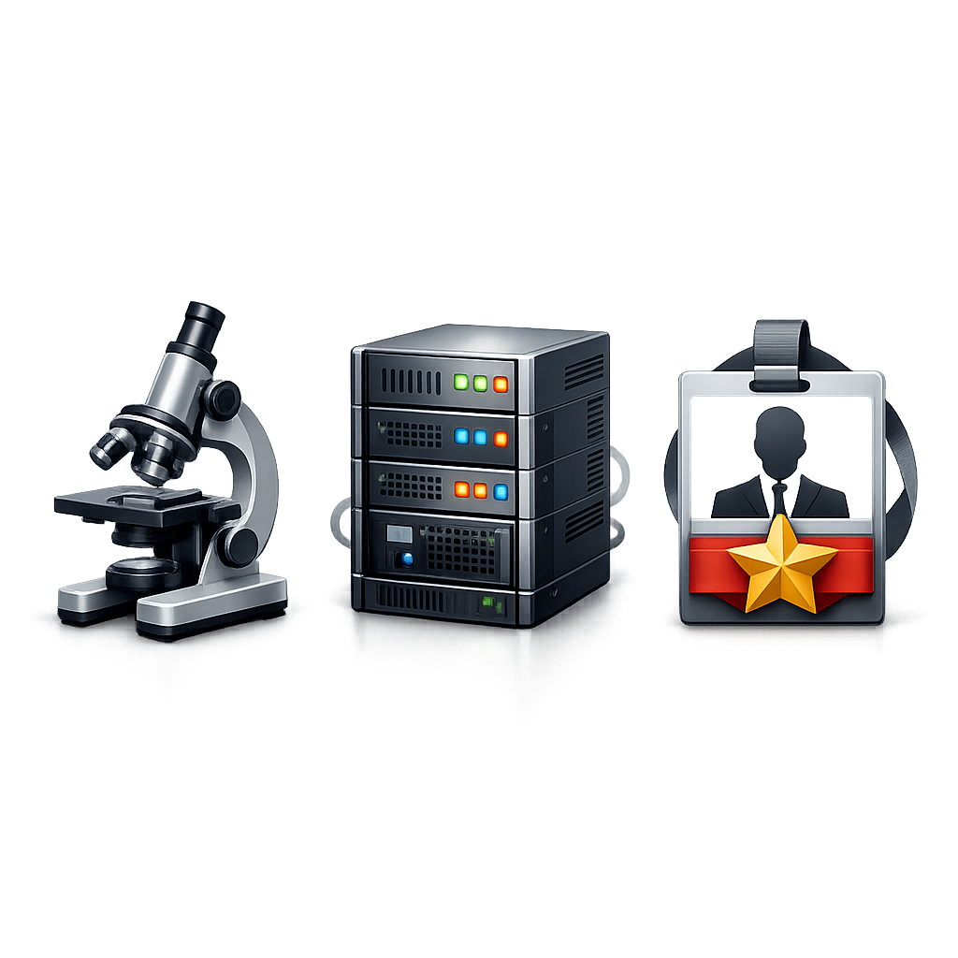
About Today’s Speaker
Technology Manager, Laboratory Applications — Sanford Health
ASCP certified as a Clinical Laboratory Scientist
Master’s in Healthcare Administration
Chair, ND Clinical Laboratory Practice Board
20+ years in lab science, pathology operations, and healthcare IT
Oversees Epic Beaker, instrument interfaces, and point‑of‑care systems
Notes:
I’ll keep this brief, but I want to give you context for why I’m passionate about this topic. I’ve spent more than 20 years moving between clinical laboratory science, pathology operations, and healthcare IT leadership. That blended background gives me a unique vantage point: I’ve lived the pain points of the lab, and I’ve also lived the constraints and pressures of IT. My team supports Epic Beaker, instrument interfaces, and point‑of‑care systems across Sanford Health’s growing footprint. Every day, we see how technology decisions ripple into lab operations. My goal today is to help bridge that gap—so laboratorians can better understand IT, and IT can better understand the lab.

Slide 3
Disclosure
I have no conflict of interest to disclose

Slide 4
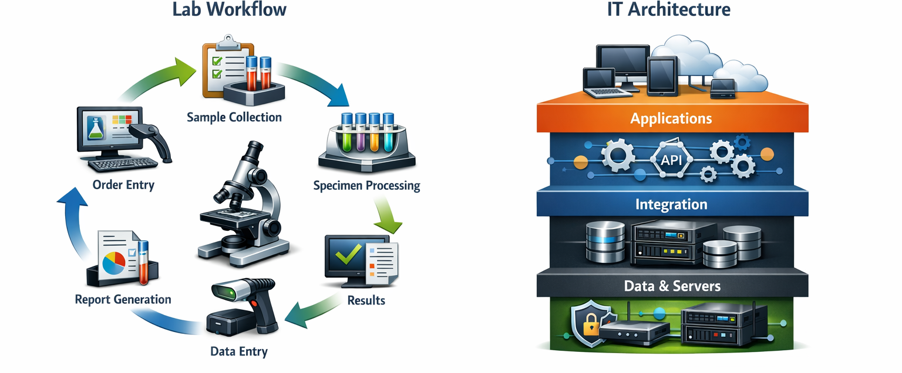
Session Synopsis
This session provides laboratorians with an insider’s view of the rapidly evolving healthcare IT landscape and its direct impact on laboratory operations. You will learn:
What drives IT decision making
How IT choices affect workflow and integration
How to build stronger partnerships with IT
How to prepare the lab for future technologies
Notes:
This session is designed to give you an insider’s view of how IT decisions are made, why certain things take longer than we want, and how those decisions impact your daily work. We’ll talk about workflows, integration challenges, communication gaps, and the technologies that are reshaping the lab. Most importantly, we’ll talk about how to build stronger partnerships with IT so we can reduce friction, improve safety, and prepare for the future. This isn’t a technical lecture—it’s a practical conversation about how we work better together.

Slide 5

What is Your Lab’s Biggest IT Challenge?
Interoperability
Downtime
Automation Support
Analytics
Cybersecurity
Communication
Many others?!?
Notes:
Let’s start with a quick pulse check. What is your lab’s biggest IT challenge right now?
Interoperability. Downtime. Communication. Cybersecurity. Analytics. These aren’t isolated problems—they’re systemic challenges that every lab is facing. We’ll come back to these themes throughout the session.
Interoperability = the ability of computer systems or software to exchange and make use of information.

Slide 6
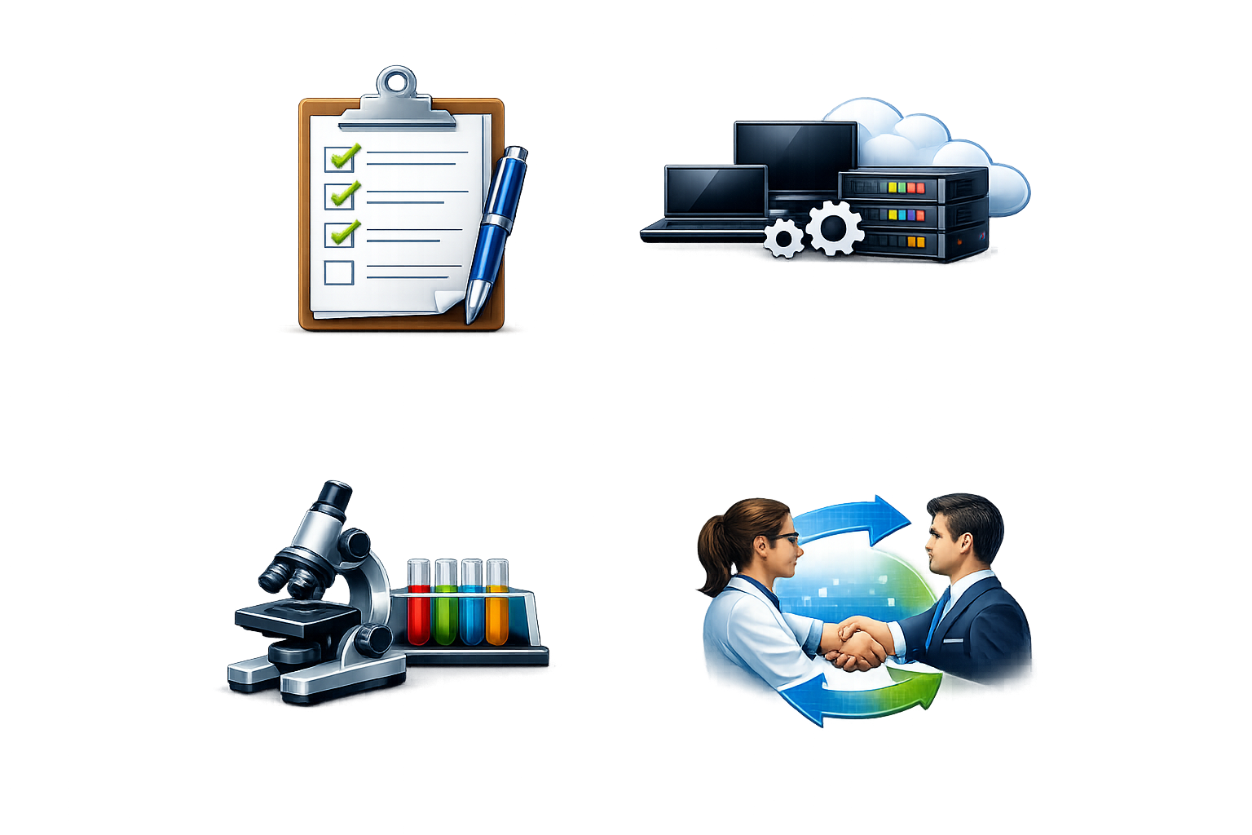
Learning Objectives
Describe current healthcare IT priorities and challenges.
Evaluate emerging technologies and their impact on lab operations.
Identify strategies to strengthen IT-lab collaboration.
Notes:
Here’s what we’re going to accomplish today. First, we’ll look at the current priorities and challenges in healthcare IT and how they directly influence lab operations. Second, we’ll evaluate emerging technologies—automation, AI, interoperability, analytics, cybersecurity—and how they’re reshaping decision making and patient outcomes. Finally, we’ll identify practical strategies to strengthen collaboration between IT and the lab. By the end of this session, you’ll have a clearer understanding of how IT thinks, what drives their decisions, and how to work with them more effectively.

Slide 7
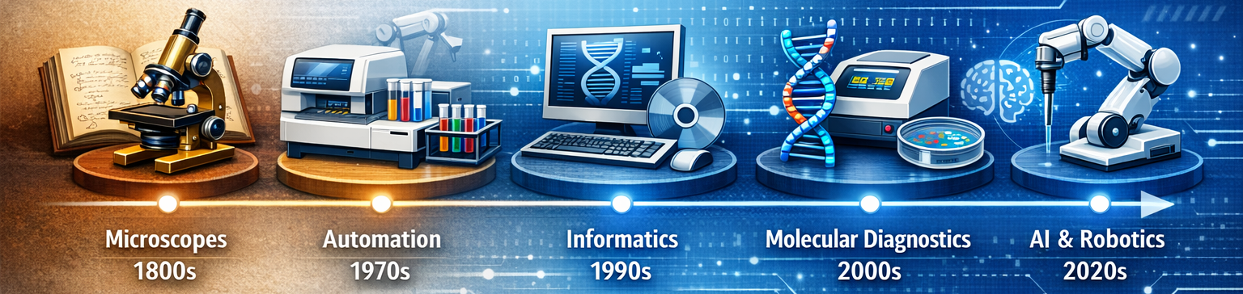
Why This Matters in 2026
Increasing system complexity
Rising expectations for speed and accuracy
Staffing shortages
Cybersecurity threats
Pressure to modernize
Notes:
The lab has become one of the most technology‑dependent environments in healthcare. Every specimen, every result, every workflow touches multiple systems. At the same time, expectations are rising—faster turnaround times, more transparency, fewer errors, more automation. Add staffing shortages, cybersecurity threats, and pressure to modernize, and you have a perfect storm. This is why understanding IT isn’t optional anymore. It’s essential to running a safe, efficient, modern laboratory.

Slide 8
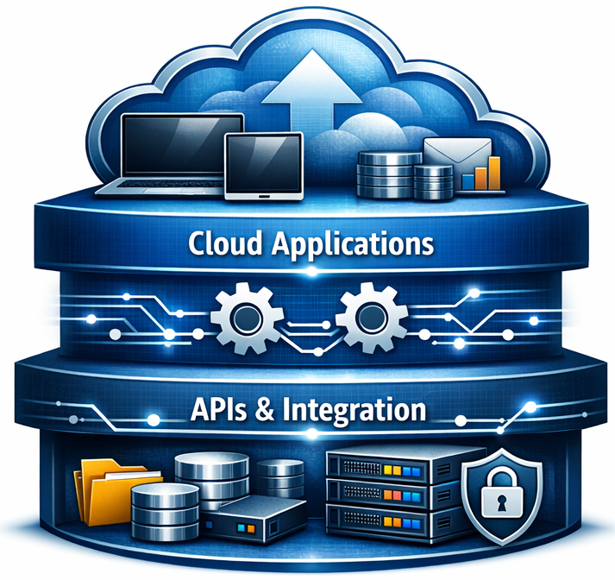
Healthcare IT Priorities in 2026
Interoperability
Data modernization
Cloud migration
Cybersecurity
Budget constraints
Notes:
Let’s talk about what’s driving IT right now. Interoperability is a national priority (Interoperability = the ability of computer systems or software to exchange and make use of information.)
—FHIR (Fast Healthcare Interoperability Resources ), HL7 (Health Level 7), data exchange.
Data modernization is pushing organizations to rethink how information flows.
Cloud migration is accelerating, which changes how systems are supported and secured.
Cybersecurity is now a top‑three organizational risk.
And of course, budgets are tight, and IT is being asked to do more with less. Understanding these pressures helps explain why IT sometimes says “not yet” or “we need to prioritize differently.”

Slide 9
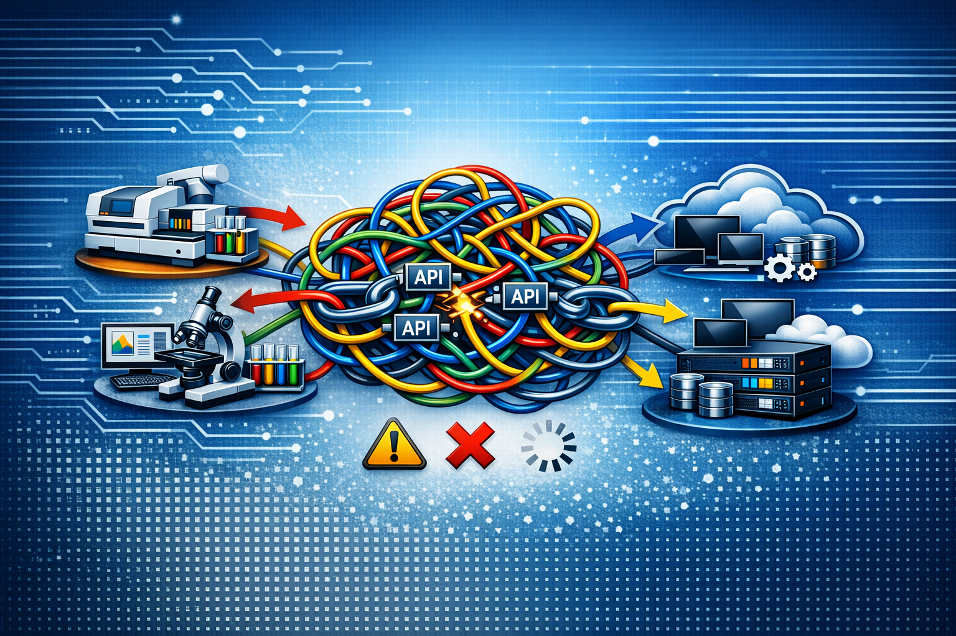
IT Challenges Impacting the Lab
Fragmented systems
Middleware overload
Downtime and patches
Slow change‑control
Limited IT staffing
Notes:
From the lab’s perspective, IT challenges often show up as frustration.
Fragmented systems that don’t talk to each other.
Middleware layers that create complexity.
Downtime windows that disrupt workflows.
Slow change‑control processes that delay fixes.
And limited IT staffing that leads to long ticket queues.
But behind each of these challenges is a real constraint—security, regulatory requirements, resource limitations, or competing priorities. Understanding the “why” behind these issues helps us collaborate more effectively.
API stands for Application Programming Interface

Slide 10
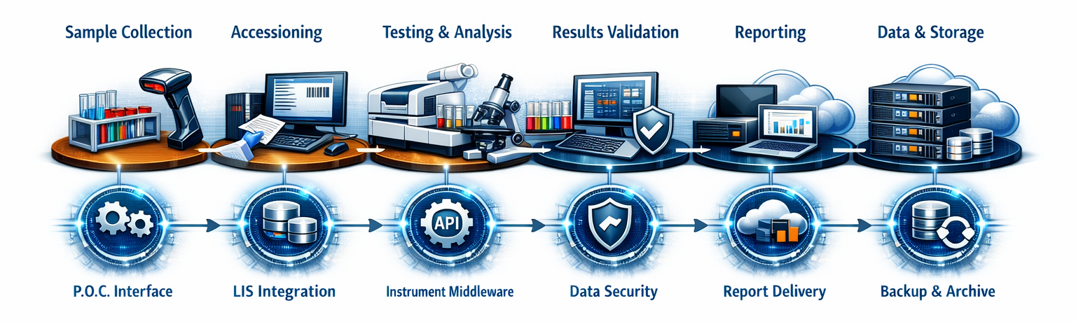
A Day in the Life of the Lab
Notes:
Collection → Accessioning → Testing → Reporting
IT touchpoints everywhere
Small delays = big bottlenecks
Manual workarounds increase risk
Let’s walk through a typical lab workflow. Specimen collection. Client orders to your EMR. Accessioning. Testing. Verification. Reporting. Every step touches IT systems—barcode scanners, automation tracks, middleware, LIS, EHR, interfaces, analytics dashboards. When everything works, it’s seamless. But when one piece slows down—even by a few seconds—it cascades. A delay in middleware becomes a delay in LIS, which becomes a delay in the EHR, which becomes a phone call from a provider. This is why IT issues feel so disruptive: the lab is a tightly coupled system.

Slide 11
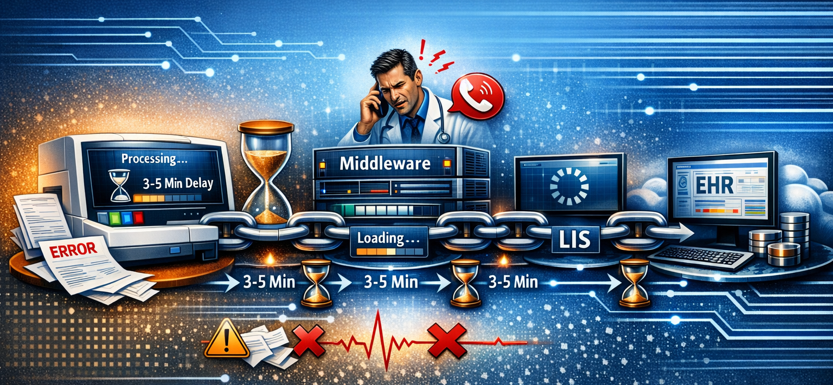
Case Example: Interface Lag
Notes:
Here’s a scenario many of you have lived. An analyzer sends results to middleware. Middleware sends them to the LIS. The LIS sends them to the EHR. But there’s a 3–5 minute delay. Techs start refreshing screens. Providers start calling. Stress goes up. Error risk increases. This isn’t just an inconvenience—it’s a patient safety issue. And often, the root cause is something invisible: a server load issue, a network bottleneck, or a middleware configuration. This is why IT–lab communication is so important.

Slide 12
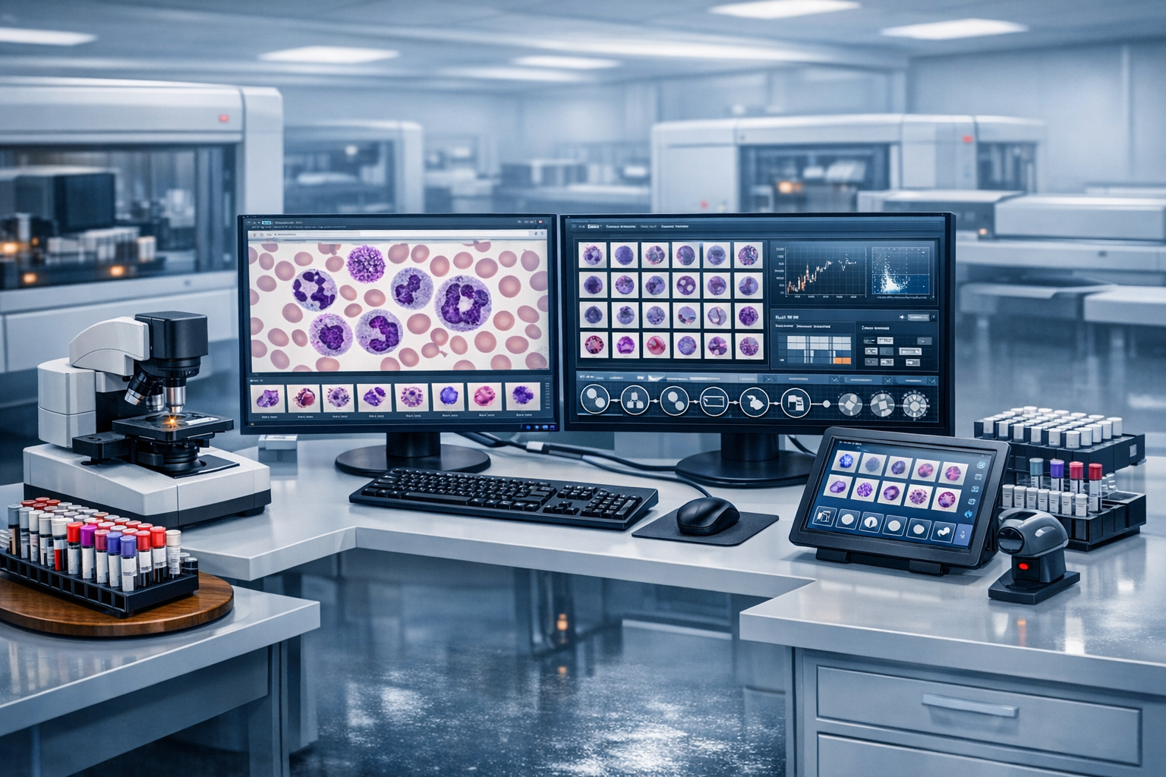
Automation in 2026
Total lab automation
Automated routing
Digital morphology
Automated QC
Robotics in micro/chemistry
Notes:
Automation is expanding rapidly—Total Lab Automation, automated routing, robotics, digital morphology.
These systems reduce variability, support staffing shortages, and improve consistency.
But they also increase IT complexity. Automation requires stable interfaces, reliable networks, and strong support structures. When automation goes down, the lab feels it immediately. This is why IT involvement in automation planning is critical from day one.

Slide 13
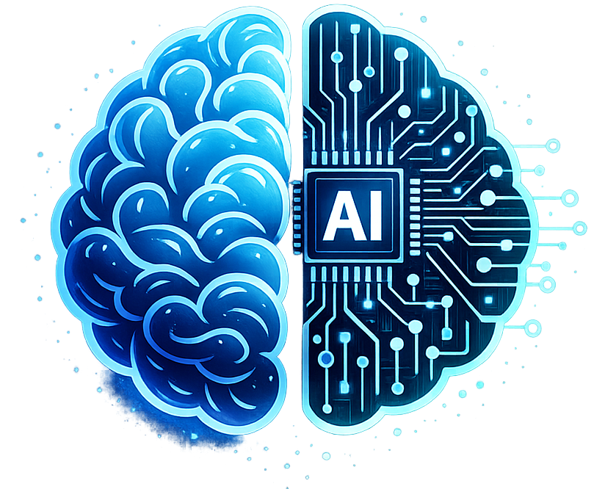
AI in the Modern Lab
AI‑assisted validation
Predictive QC
Reflex optimization
Pattern recognition
Workload balancing
Notes:
AI is no longer theoretical—it’s here. AI‑assisted validation, predictive QC, pattern recognition, reflex rule optimization. AI can reduce manual review, improve consistency, and help techs focus on complex cases. But AI is only as good as the data feeding it. If your LIS data is inconsistent, incomplete, or poorly structured, AI will struggle. This is another reason why IT–lab collaboration matters: data quality is a shared responsibility.

Slide 14
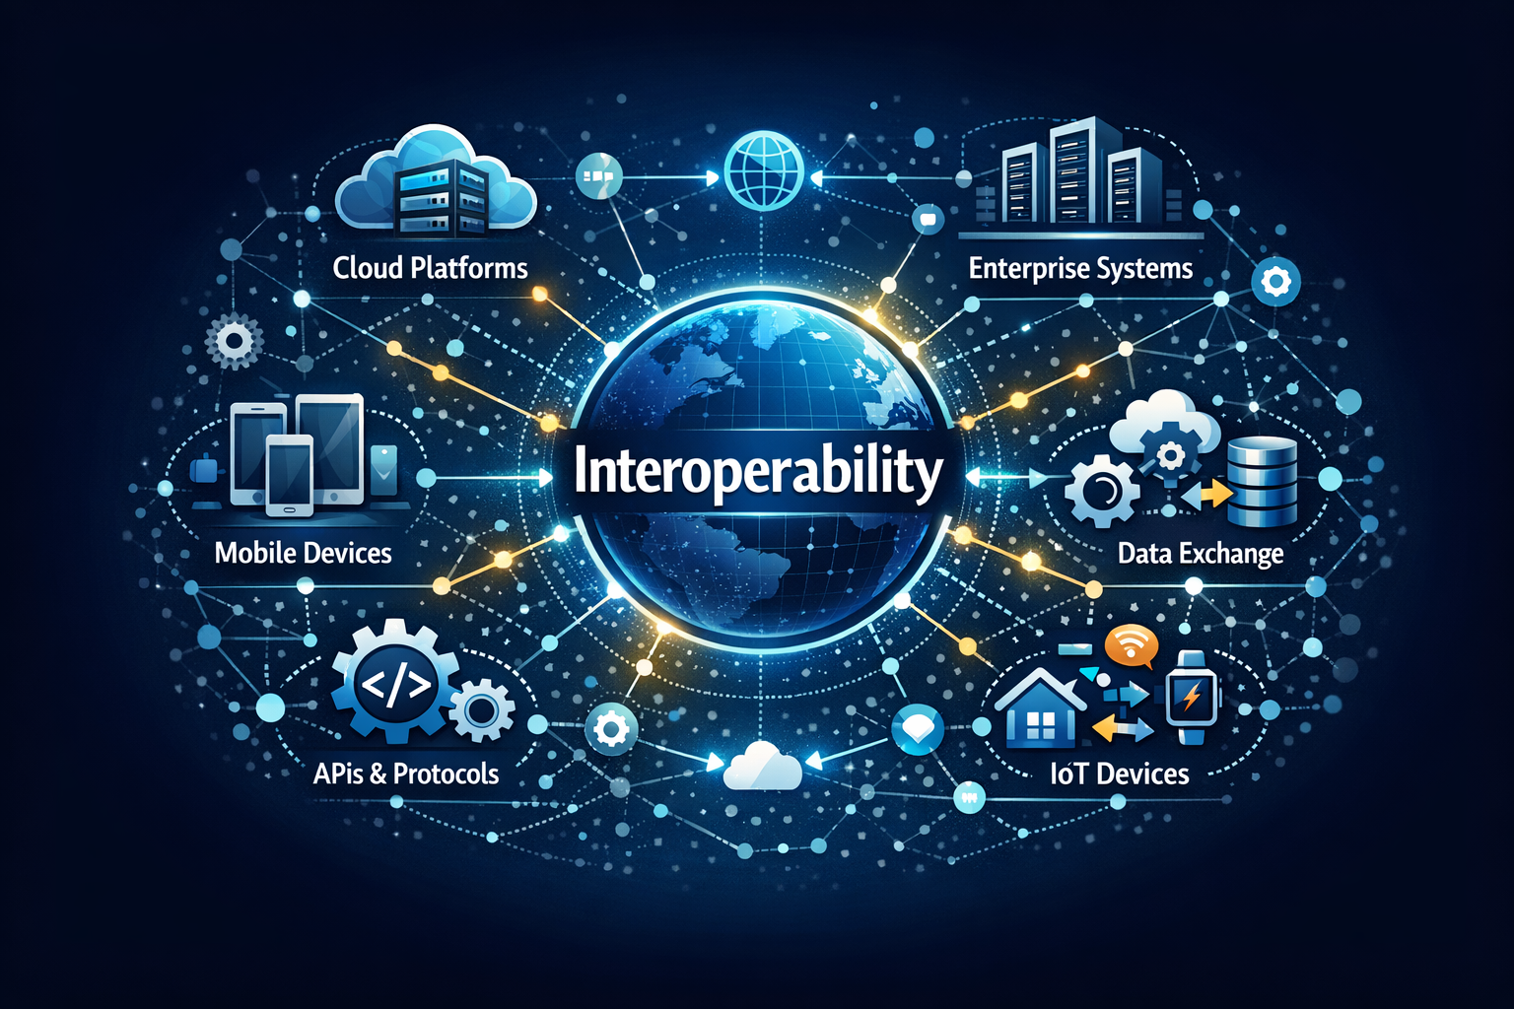
The Connected Laboratory
HL7
LIS ↔ EHR ↔ Public health
Real‑time data
Fewer manual steps
Better visibility
Notes:
Interoperability is the backbone of modern lab operations. HL7 enables real‑time data exchange between LIS, EHR, public health systems, and analytics platforms. When interoperability works, manual steps disappear.
Reflex rules fire automatically. Providers get results faster. Public health reporting becomes seamless. When it doesn’t work, the lab becomes the bottleneck—even when the issue isn’t in the lab at all.

Slide 15
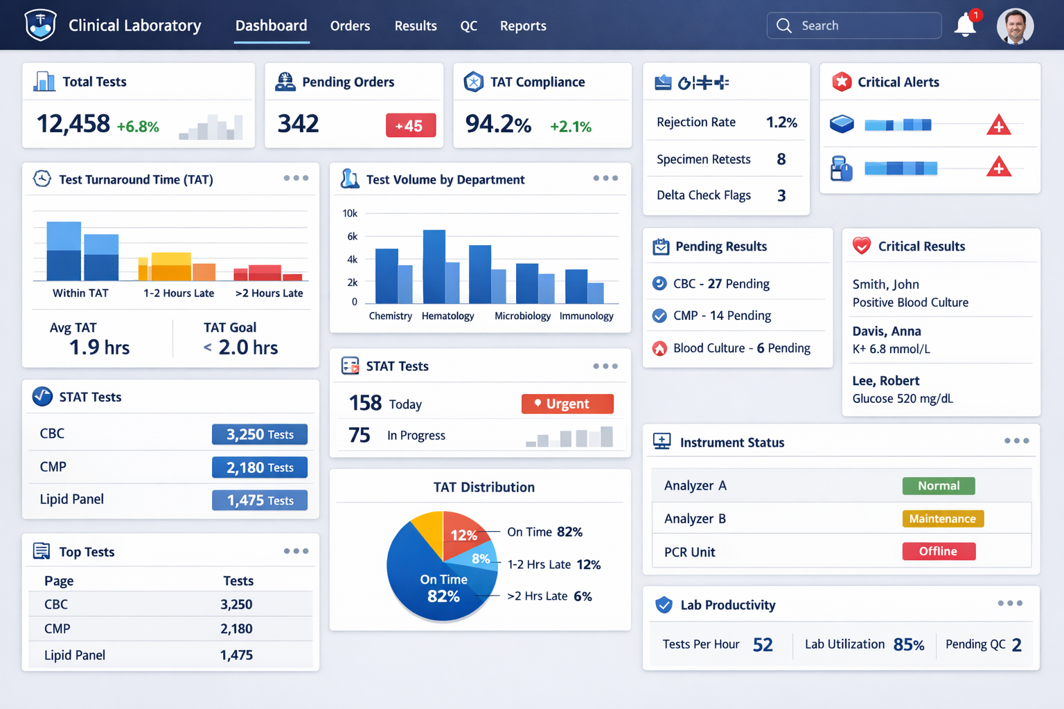
Data‑Driven Operations
TAT dashboards
Error monitoring
Instrument utilization
Staffing predictions
Quality insights
Notes:
Analytics are transforming how labs operate. Dashboards show TAT trends, error rates, instrument utilization, staffing needs. Predictive analytics can identify when an instrument is likely to fail or when staffing shortages will impact TAT. Data helps justify resources, support quality initiatives, and demonstrate the lab’s value. But again, analytics depend on clean, consistent data—and that requires IT partnership.

Slide 16
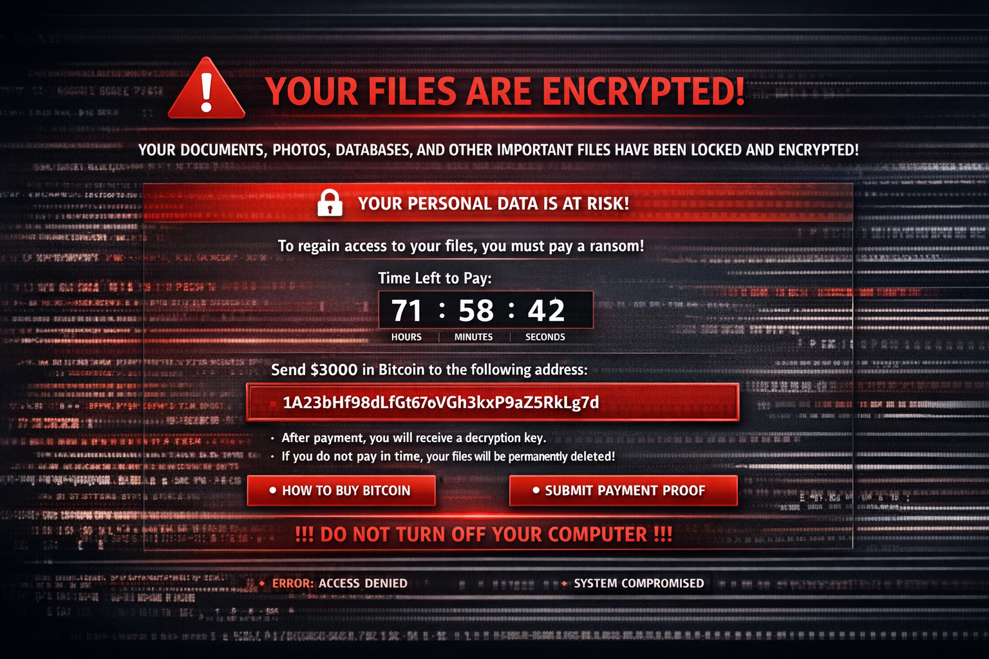
Cybersecurity Threats
Ransomware
Vulnerable instruments
Downtime risks
Data integrity
Regulatory impact
Notes:
Cybersecurity is one of the biggest threats to laboratory operations today. Ransomware attacks can take down LIS systems, instruments, middleware, and EHRs. Many lab instruments run on outdated operating systems, making them vulnerable. Downtime procedures are no longer optional—they’re essential. Cybersecurity isn’t just an IT issue. It’s a patient safety issue, and the lab plays a critical role in preparedness.

Slide 17
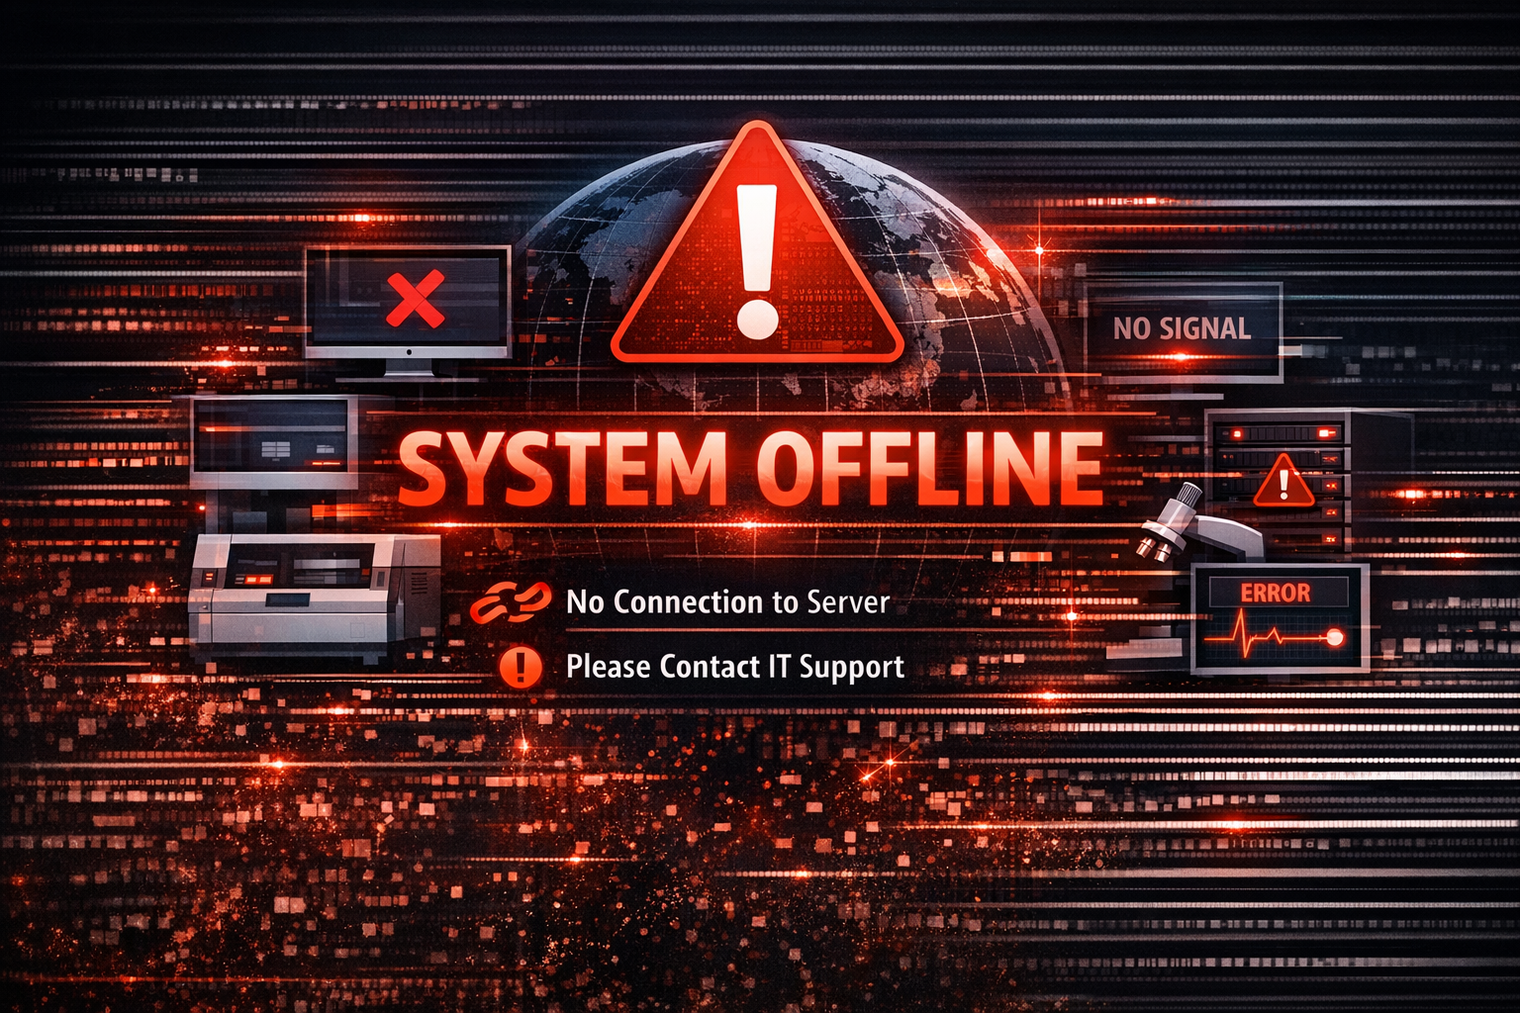
When IT Fails
LIS offline
Manual entry
Delayed care
Error risk
Burnout
Notes:
Let’s look at a real scenario. A ransomware attack hits the organization. The LIS goes offline. The lab moves to manual processes—paper logs, manual result entry, phone calls. Turnaround times skyrocket. Error risk increases. Staff burnout intensifies. This is the cost of IT failure. And it’s why cybersecurity and downtime planning must be shared priorities.

Slide 18
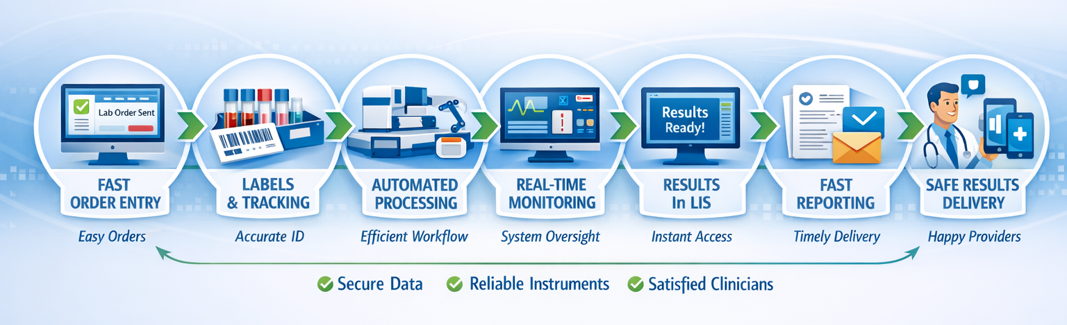
When IT Works
Notes:
Now let’s look at the opposite scenario. A lab implements automated reflex testing supported by strong interoperability. Results flow seamlessly. Manual steps disappear. Providers get faster, more consistent results. Patient outcomes improve. This is what happens when IT and the lab work together from the start.

Slide 19
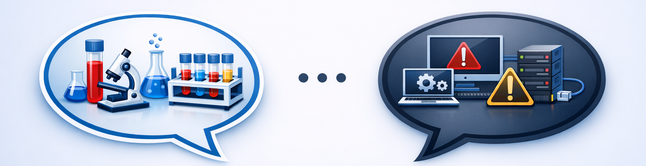
The IT–Lab Communication Gap
Different vocabularies
Different priorities
Different timelines
Misaligned expectations
Limited cross‑training
Notes:
One of the biggest barriers to success is communication. IT and lab teams speak different languages, have different priorities, and operate on different timelines. IT thinks in terms of security, scalability, and risk. The lab thinks in terms of workflow, turnaround time, and patient care. Neither perspective is wrong—they’re just different. Bridging this gap requires intentional effort. IT Lab becomes Star Trek universal translator. We can hopefully speak both languages.

Slide 20
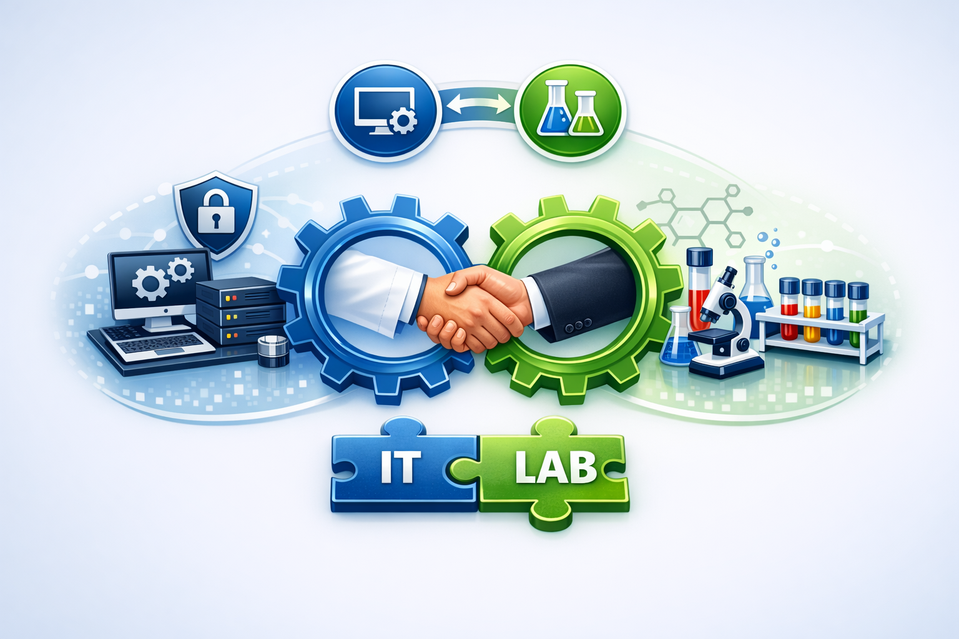
Bridging the Gap
Joint planning
Shared KPIs
Cross‑training
Clear escalation
Regular touchpoints
Notes:
Here are strategies that work. Joint planning sessions ensure IT understands lab workflows and the lab understands IT constraints. Shared Key Performance Indicators align priorities. Cross‑training builds empathy and shared understanding. Clear escalation pathways reduce frustration. Regular touchpoints keep communication flowing. These aren’t theoretical—they’re practical steps that labs across the country are using successfully.

Slide 21
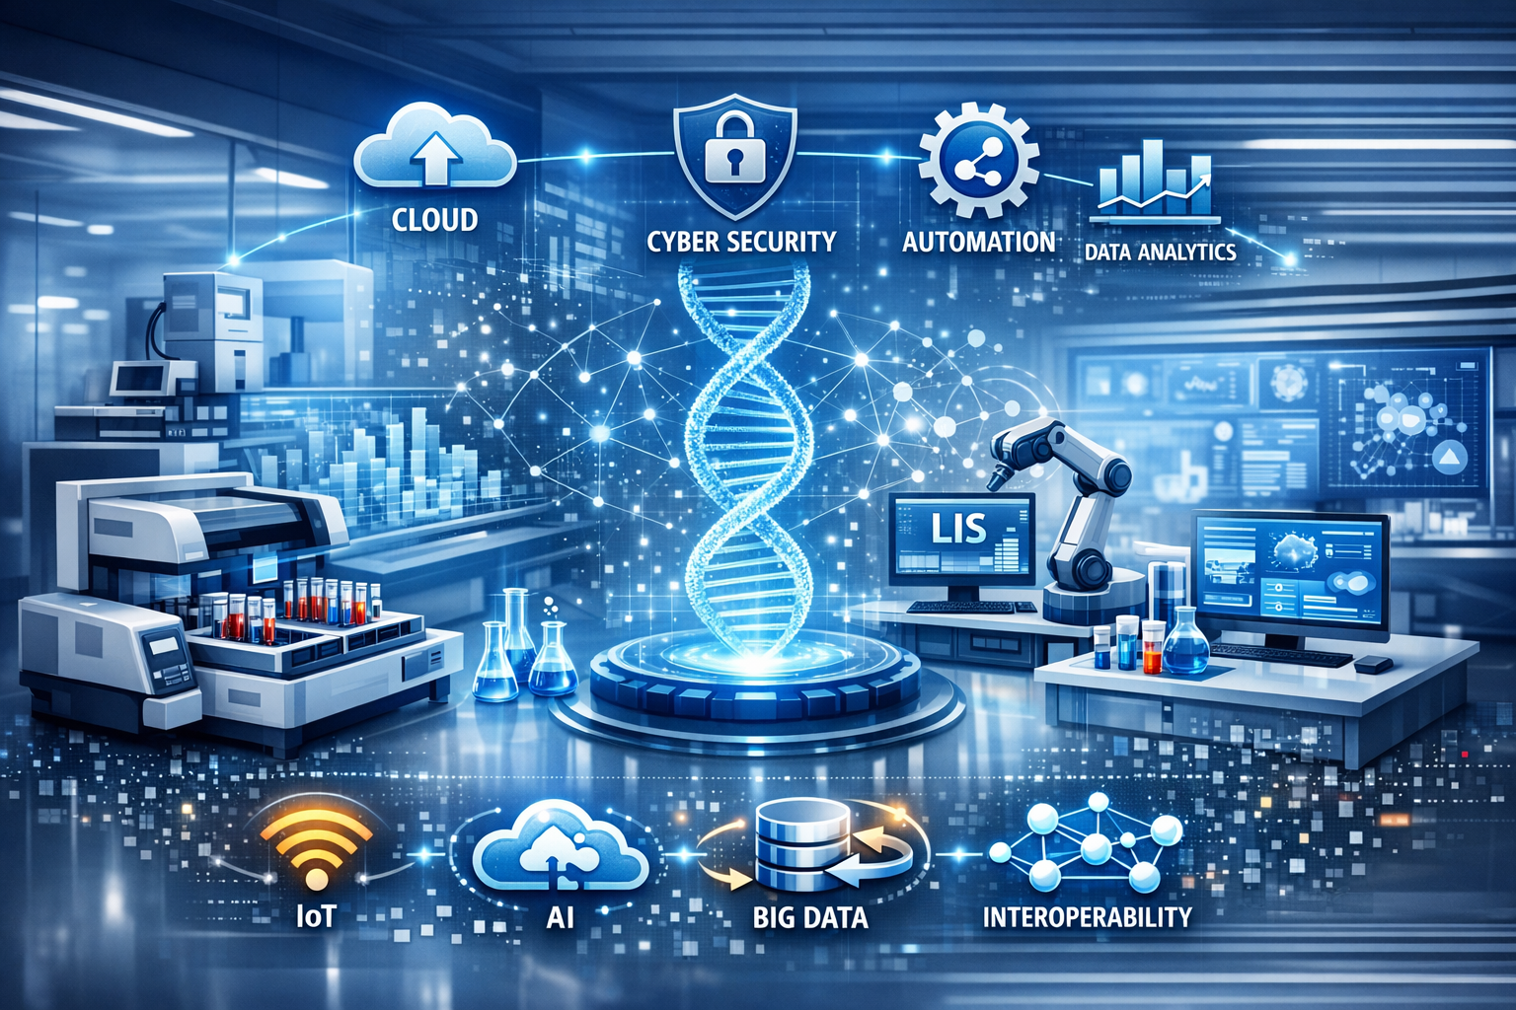
Preparing for the Future
Scalable systems
Strong cybersecurity
Prioritize interoperability
Workforce development
IT–lab partnerships
Notes:
The lab of the future will be more automated, more connected, and more data‑driven. To prepare, we need scalable systems, strong cybersecurity, and a workforce that understands both lab science and technology. We also need to build strong partnerships with IT—because the future of the lab is inseparable from the future of healthcare technology.
The Internet of Things (IoT) refers to a network of physical objects ("things") embedded with sensors, software, and technologies that enable them to collect, exchange, and act on data over the internet without human intervention.

Slide 22
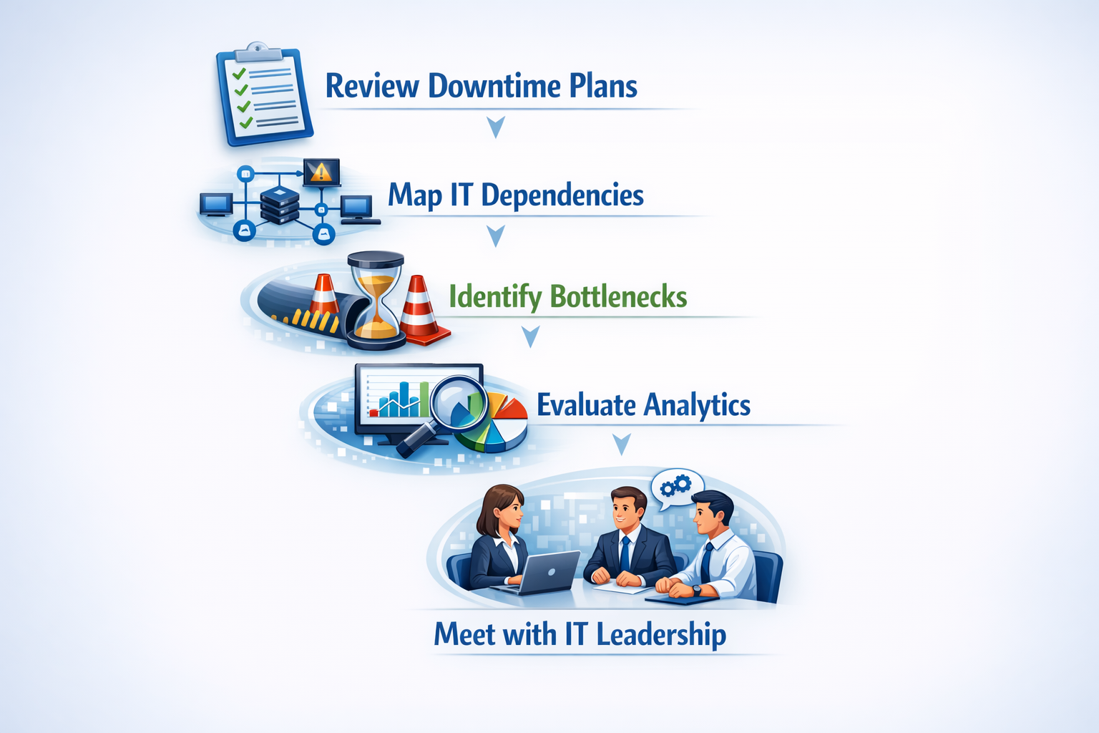
What You Can Do Tomorrow
Notes:
Here are practical steps you can take immediately. Review your downtime procedures—are they current? Map your IT dependencies—do you know what systems your workflows rely on? Identify your biggest bottleneck—what’s slowing you down the most? Evaluate your analytics—are you using data effectively? Schedule a meeting with IT leadership—start building the relationship now. Small steps can create big improvements.

Slide 23
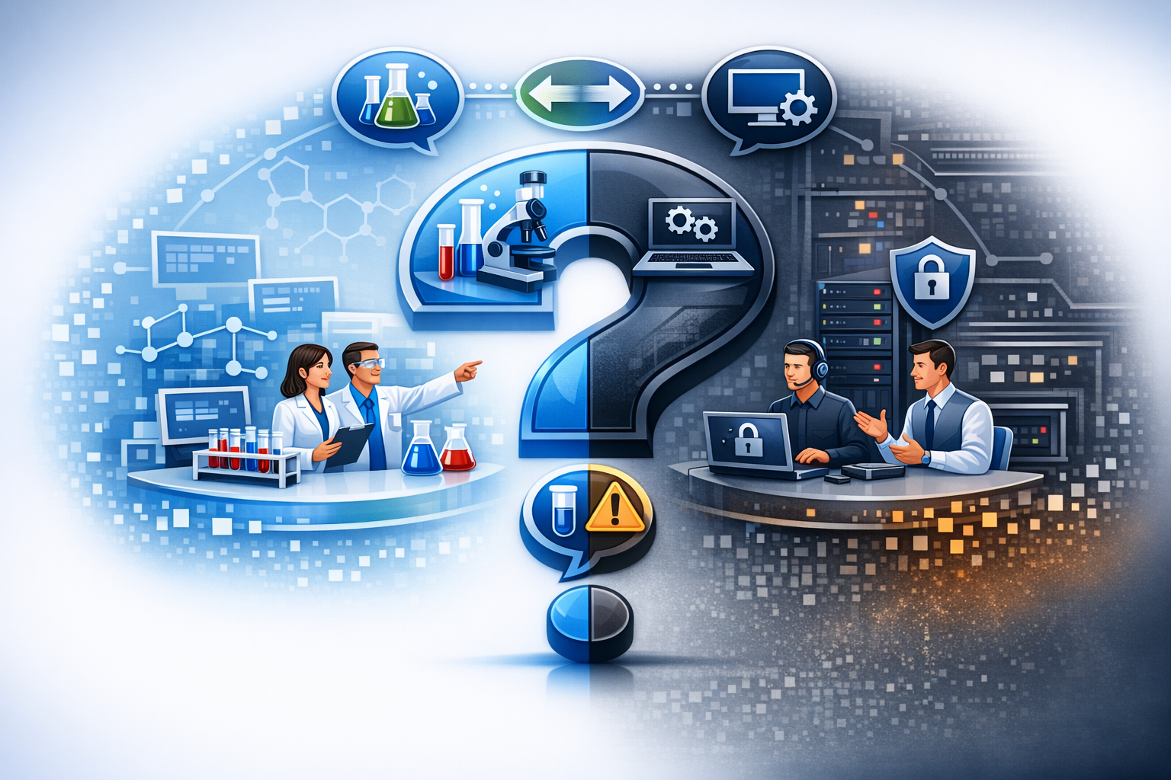
Questions & Discussion
Notes:
I’d love to hear your questions, your experiences, and your challenges. What resonates with you? What IT issues are impacting your lab today? What successes have you had in building partnerships with IT?

Slide 24
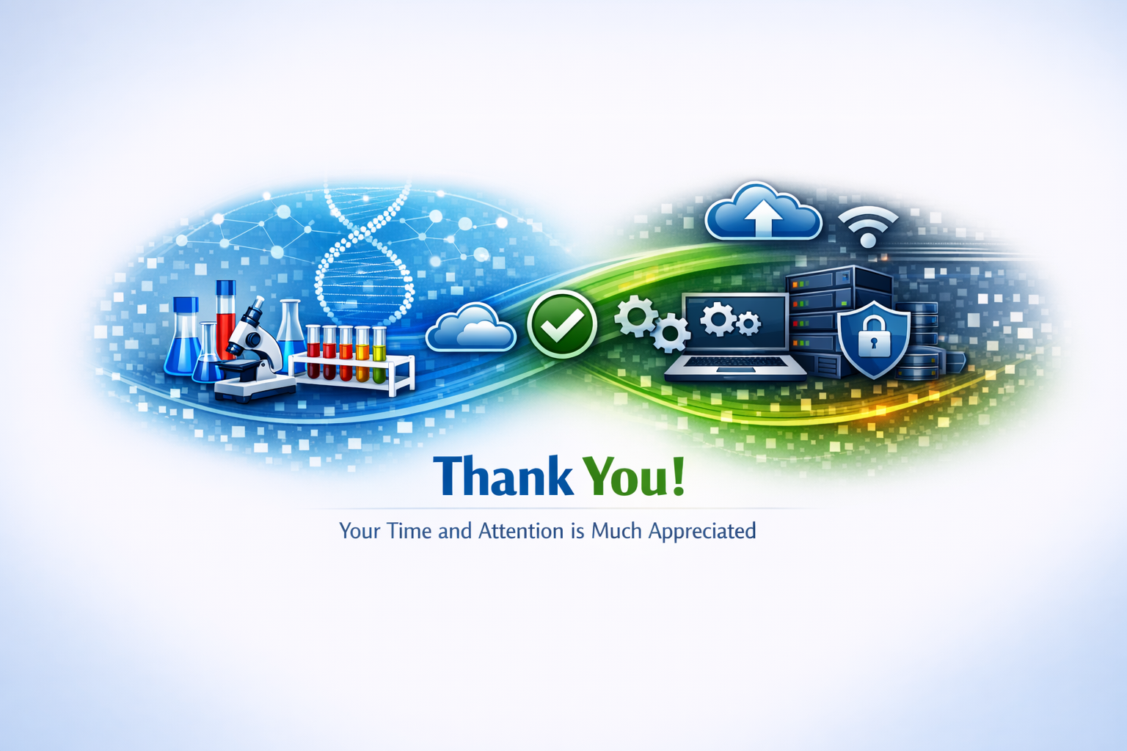
Notes:
Thank you for spending this time with me today. I hope this session gave you new insights into how IT and the lab can work together more effectively. Please feel free to reach out if you’d like to continue the conversation or need support in your own organization.

