Slide 1


Submitting Driver requests
User Group 2026
Notes:
Introduce myself.
I'd like to start with seeing who has made a driver enhancement or a new driver request within the last 6 months or so. - ask about the experience
We've been working on continuous improvement of the process and education of our engineering team as it grows. So it will be good to hear from those of you with recent experiences if we are hitting the mark.
1

Slide 2
Agenda
01
What purpose do drivers serve in Instrument Manager?
02
When to submit a request
03
How to submit requests
04
What to expect during the request process
2
Notes:
Agenda Slide
2

Slide 3
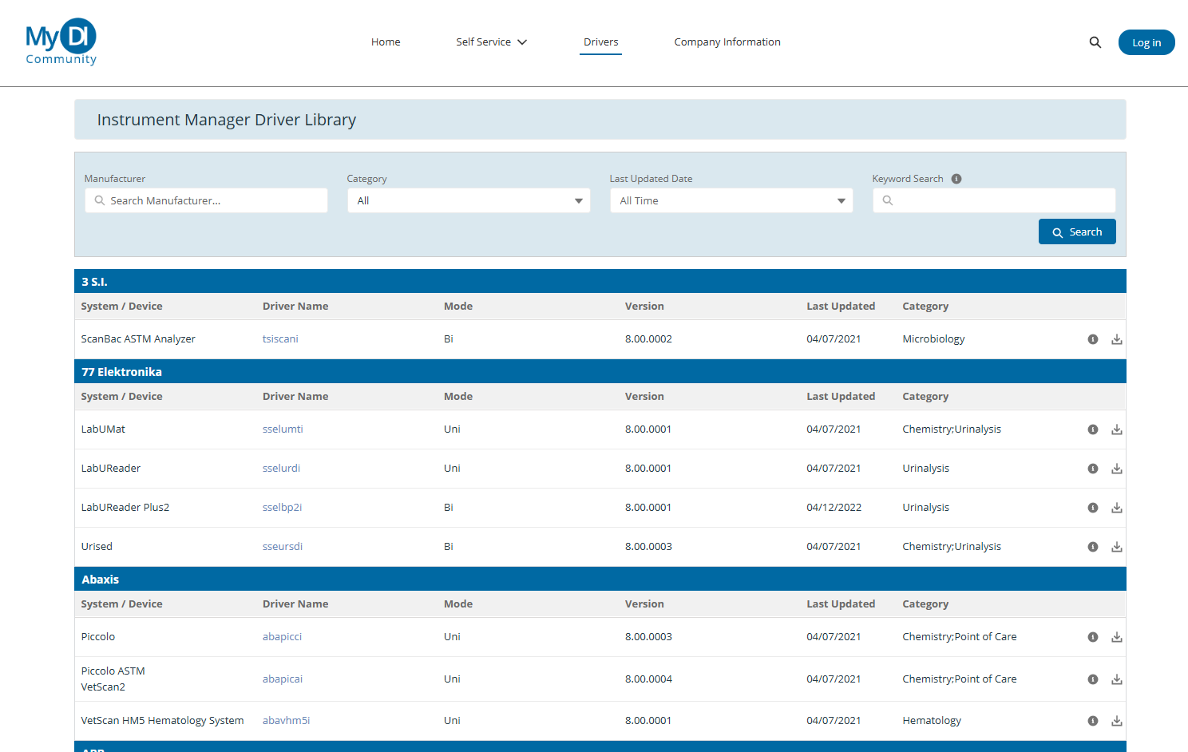
What are drivers?
Enable communication between a device and Instrument Manager
such as an instrument, LIS/EMR, QC system, automation controller, and more
Custom coded software installed in Instrument Manager
We have over 1300 Drivers in our library!
3
Notes:
The term driver gets used very often, but at DI it enables data flow and manipulation from one connection (be it an instruent, LIS, etc) to another. Because we use a driver to direct, translate and manipulate data it opens up doors like connectivity to QC systems or CAP connectivity. Lots of creatie ways drivers can be used.
Our biggest claim to fame and what we are most proud of is our driver library of 1300 vendor neutral drivers.
3

Slide 4
Our philosophy on drivers
We maintain a large and constantly updated library of drivers because we understand that laboratory connectivity needs are constantly evolving:
IVD manufacturers update their software
IVD manufacturers release new instruments
LIS/EMR systems change over time
Everyone's laboratory is different
We proudly maintain a device manufacturer neutral policy
We will connect any device in your lab to instrument manager regardless of the manufacturer
New and updated drivers may be downloaded and installed freely for anyone on an active M&S plan with Data Innovations
4
Notes:
So why do we maintain such a large library and why is it constantly changing? READ slide Any other reasons you can think of?
Again, being vendor neutral makes us unique – we do not have the constraint of being owned by an instrument or LIS vendor.
And one of the things I liked best when I was a customer is the ability to download any driver I wanted from the library – this is covered by maintenance and support fees.
4

Slide 5
What are driver requests?
Customers on a current M&S plan can submit requests to DI for driver changes. This can include:
A request for a new driver
A request to enhance (change) a driver
Considering purchasing a device
Be able to process data available in the message
Have a device you want to interface to IM
Achieve a new workflow
5
Notes:
So driver request are typically made for a new driver when a new instrument is being purchased or an instrument that previously could not be interfaces now can.
It's important to work with the lab on their upcoming instrument purchases so a new interface can be ready in time for testing and validation
Enhancement requests come for new workflows sometime in the LIS, but sometimes the instrument itself will update software.
5

Slide 6
When to make a request – new driver
Example of when you would request a new driver:
Example of when not to request a new driver:
You are planning to purchase and/or implement a new instrument driver, and the driver is not listed in our driver library
You need help understanding which driver to select for your device
An inquiry for assistance can be submitted to support or to your sales rep
A driver for a device you wish to connect to instrument manager is not listed within the 1300 drivers available today
You wish to download an existing driver from my DI community
You are interested in being a test site for the driver
The driver search and download function can be leveraged to achieve this task
6
Notes:
Let's talk a bit more about the 2 types of requests -
A New driver -
One of the pain points between Lab and LIS is when new instrumentation is purchased. Does anyone have a good method for collaboration between the lab and LIS when instrumentation is being selected?
So if you are planning a new purchase – check out the drivers webpage and see if there is an existing driver. If you aren't sure submit a support ticket with the specs for help. Or you can download a driver in question to your test system and see if the help file gives you any guidance.
If there isn't an existing driver – please put in the request as soon as possible.
6

Slide 7
When to make a request – new driver
To expedite processing:
Interface specifications
Vendor contact and contact information
What does the device do?
What LIS and driver are you using?
Are you willing to test the driver and what is your desired go-live date for the device?
7
Notes:
Including the listed items in the request really helps expedite the process. DI tries to provide drivers that not only transfer data but that fits into the lab and LIS workflows – that why understanding the testing performed and your LIS are so important.
7

Slide 8
When to make a request – enhance (change) a driver
Example of when to submit a change request:
Example of when to not submit a change request:
A known software update or improvement you want to use
The change wouldn't be usable between IM and LIS
Available data the device can send and receive that isn't being used today
Driver modification is moot if it cannot be used to achieve the workflow
A workflow requirement can't be met with current functionality
Request is specific to your site and not broadly applicable
Drivers are used for multiple customer use. If there's an alternative way to help you, Data Innovations can assess.
Data exchanged isn't being processed by the driver today
8
Notes:
Now let's talk about an enhancement request:
- what if you can see data in the comm trace but don't see it in the SEL? Most likely it wasn't in the original driver specs – if you need that data to aid in your workflow – this would be a great example of when to file an enhancement request
But there are cases when it might not be helpful to submit an enhancement – maybe your LIS cannot accept the data or if the request is a custom request for your hospital.
-
8

Slide 9
When to make a request – enhance (change) a driver
To expedite processing:
Interface specifications
Vendor contact and contact information
What LIS and driver are you using?
What cannot be accomplished that is necessary?
Why is this change required?
What has been attempted to try and solve the problem?
Are you willing to test the driver and what is your desired go-live date for the device?
If available, provide comm trace and Specimen Event Logs that illustrate the request
9
Notes:
Again, we want to partner with you – by collaborating together we can move faster and get a stronger end product. The information here will help us to be that partner.
9

Slide 10
SECTION 03
How to make a request
10
Notes:
I could live demo this if we don’t want to click by click.
10

Slide 11
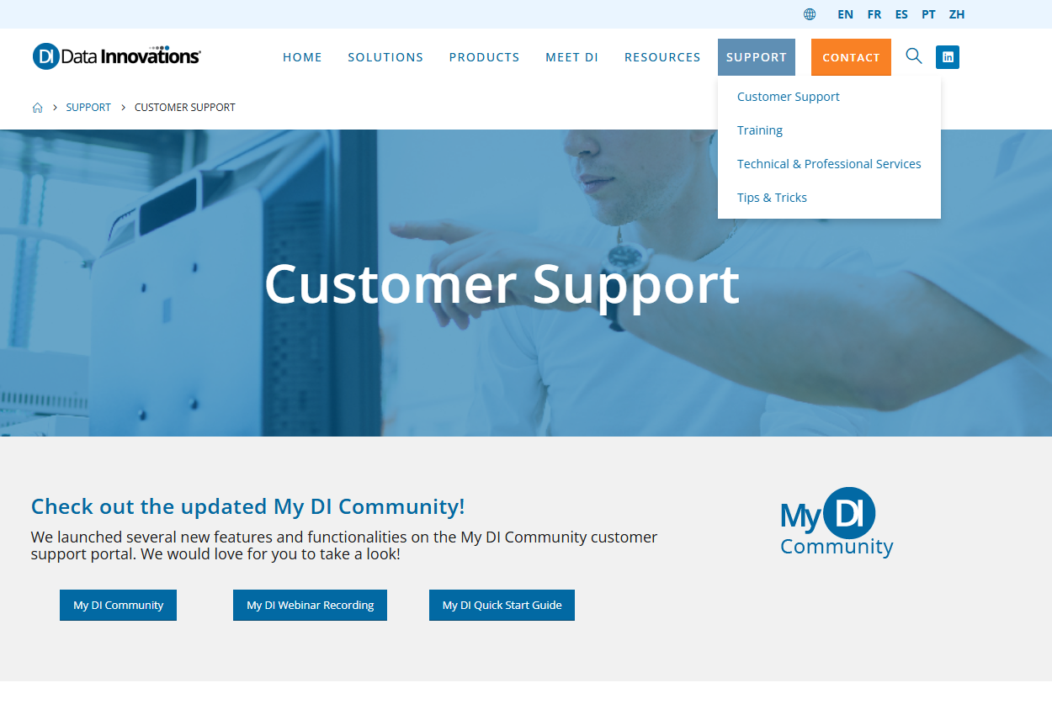
Step by step, annotated screenshots
11
Notes:
DI website
Go to Support > Customer Support
My DI Community button to log into My DI Community
11

Slide 12
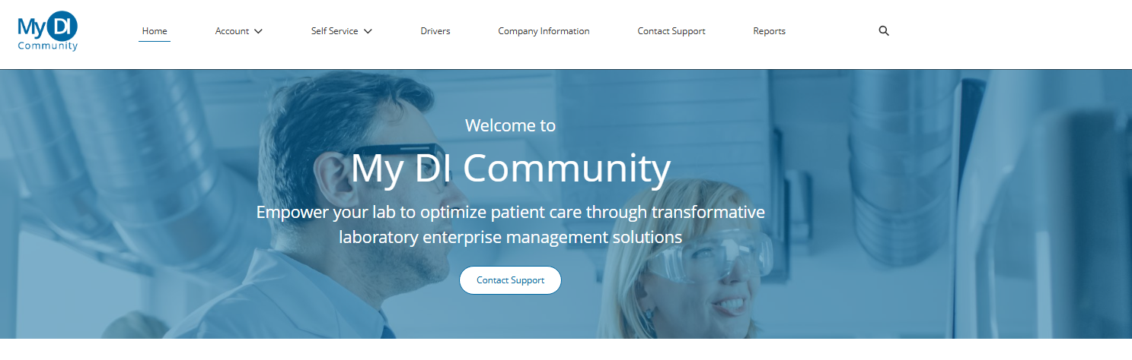
Step by step, annotated screenshots
12
Notes:
Use the "contact support" option to start your case submission
12

Slide 13
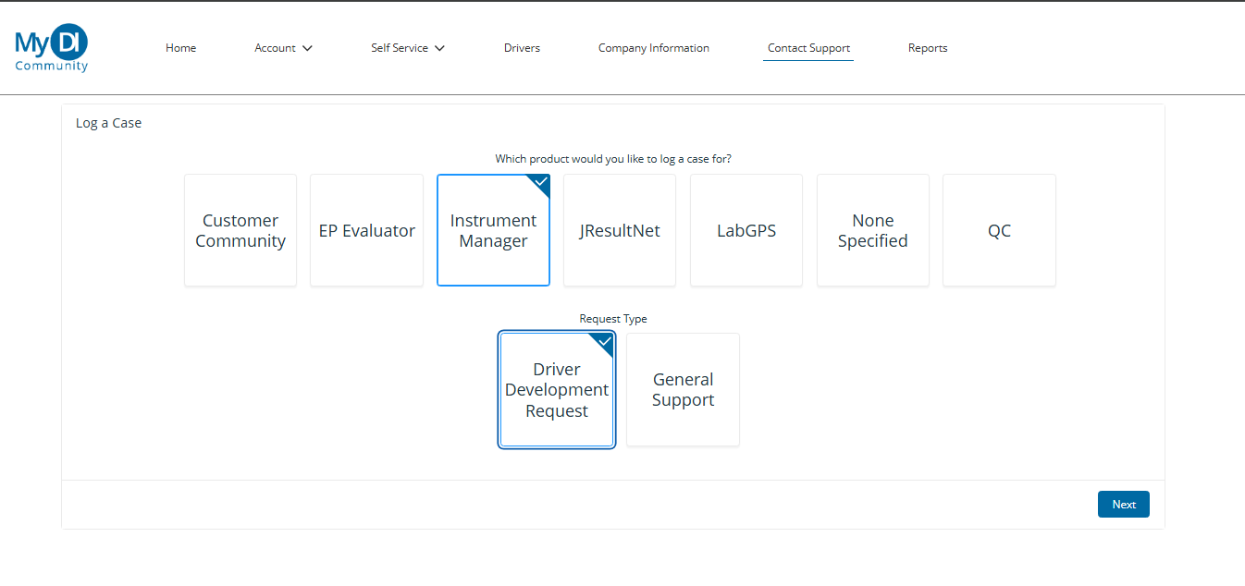
Step by step, annotated screenshots
13

Slide 14
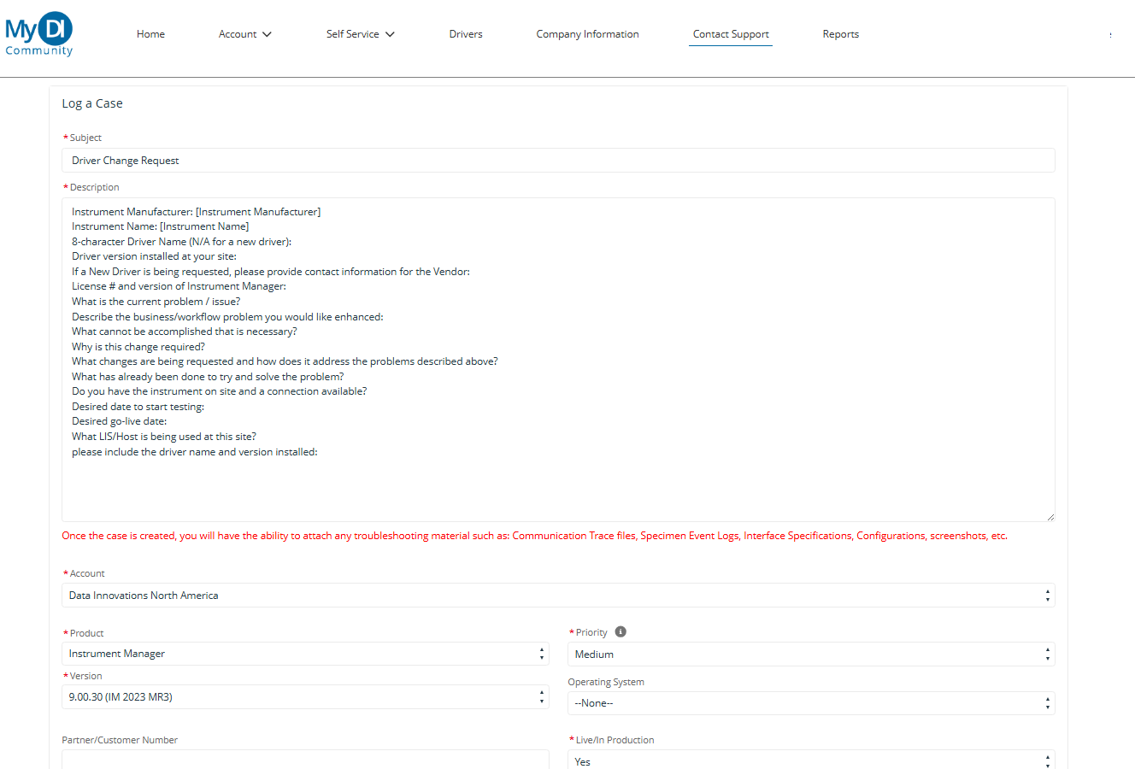
Step by step, annotated screenshots
14
Notes:
Fill in the template with information
14

Slide 15
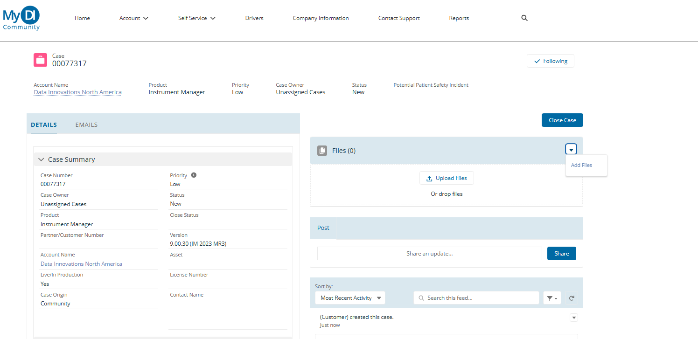
Step by step, annotated screenshots
15
Notes:
Upload the files to the case.
15

Slide 16



Our process
Evaluation and information gathering
Development
Testing
16
Notes:
We have been working continuously to improve the experience you have when working through a new driver or a driver change.
We have hired a product owner with a deep IM support background and strong knowledge of the lab.
We are focused on engineering education as we have expanded our team.
We have support and engineering working together with you as the testing progresses.
16

Slide 17
Evaluation
Product and customer collaborate on requirements
Product reviews the request
Product works with Dev to refine the work
17
Notes:
Do you always speak with the customer? requirements sent to customer and ask for understanding
17

Slide 18
Evaluation
Product works out the "What" and the "Why"
Product aligns with customer on requirements
Product interfaces with Development to determine "How" and "When"
Progress is closely tied to customer engagement
Timely collaboration is essential to move forward efficiently
18

Slide 19
Development
Work approved
Coding and review
Testing
19
Notes:
Approval means engineering understands
Code is written and reviewed if it is clinically significant it has a second code review.
Internal testing by our quality engineers
19

Slide 20
Development
Customer receives driver delivery date
Aligns with their site to test around that date
Development code and review
QA tests internal testing in the form of verification and validation
20
Notes:
By working closely together we can align with your testing schedule and give you a due date for the beta driver.
20

Slide 21
Testing
Driver Posted and available for use
Driver delivered
Customer Testing
21
Notes:
Driver is delivered through the my communities support case.
Testing evidence is outlined in driver help - comm trace or SEL. help file will be in the bundle and have instructions for testing evidence.
21

Slide 22
Testing
Beta driver, help file and customer testing information is delivered to Support Case for download
Customer tests if driver achieves their expected outcome
Customer captures evidence and delivers back to Data Innovations
Information we typically request:
Specimen event log
Comm traces of the testing
Once complete, live Driver is posted on My DI Community
22
Notes:
support and dev – Betty will become involved if changes are needed to requirements
22

Slide 23
By the numbers
2025
SUBMITTED
APPROVED
DELIVERED
New: 104 Changes: 208
New: 36 Changes: 118
New: 34 Changes: 108
2026 (Q1+Q2)
SUBMITTED
APPROVED
DELIVERED
New: 47 Changes: 70
New: 25 Changes: 50
New: 16 Changes: 40
23
Notes:
Submitted is items that came to me for evaluation. Product Owner reviews spec checks, rejections, or sometimes finds resolution through existing driver functionality.
Emphasize importance of Evaluation phase for value – you get resolution while we focus dev on the work that matters rather than spending calories chasing work that is not required.
23

Slide 24
Wrap up
New and updated drivers may be requested, downloaded and installed freely for anyone on an active M&S plan with Data Innovations
We want to work with you!
Close collaboration throughout the driver update process to achieve your workflow goals
Your request could help others
Remember the steps – Evaluation, Development, Testing
24
Notes:
Enhancement – 60 days
New driver – 120 days
In closing, Maintenance and support allow you to request new drivers and driver enhancements without an additional charge.
Need your help!!!! Evaluating the whole workflow ensure we will deliver a solution that meets you needs.
Updates to drivers help the whole DI community
Steps
Questions?
24

Slide 25
Thank you!
25

